Slide 1


Slide 2
Team name:G_5
Team members:
Ch.Sreeji
P.Nagendra Babu
P.Vamshi
K.Anusha

Slide 3
Abstract:
Smart Parking is a parking strategy that combines technology and human innovation in an effort to use as few resources as possible—such as fuel, time and space—to achieve faster, easier and denser parking of vehicles for the majority of time they remain idle.
A smart vehicle parking is a system that helps drivers to find a vacant spot using sensors in each parking space by detecting the presence or absence of a vehicle. Smart Parking systems are generally powered by electric motors (that move vehicles into a storage position).It typically obtains information about available parking spaces in a particular geographic area and process is real-time to place vehicles at available positions

Slide 4
Block diagram for smart parking system
Vcc=3v
Mobile app(output)
LED
Ultrasonic
Sensors-1
NODEMCU
ESP8266
IOT
platform
Ultrasonic
Sensors-2
Servo motor

Slide 5
Hard ware required: Nodemcu -1 Ultrasonic sensors -2 Servo motor -1 Soft ware required: Arduino IDE IBM watson Mit app inventor

Slide 6
Project highlights:
Acts as an efficient guide for driver in parking especially cab drivers.
Reduces Manual effort in finding out the empty slot
Accessing Sensor data from anywhere in the world.

Slide 7
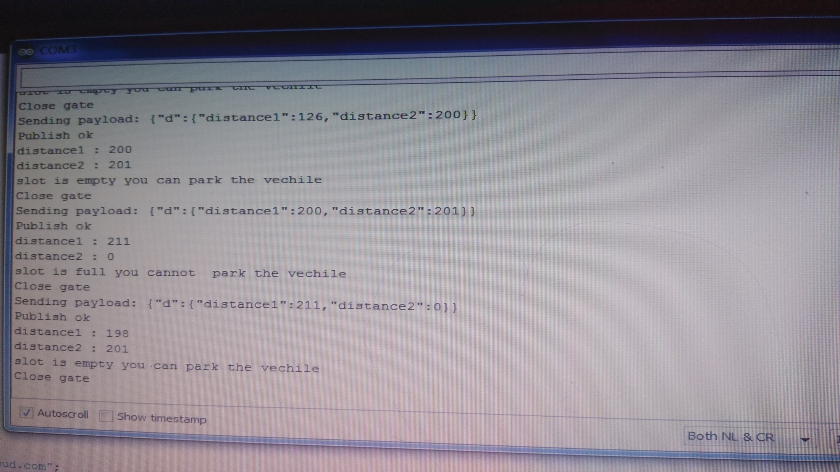

Slide 8


